Slide 1




LISE-ZDD project in
Ozge Aktas

Slide 2
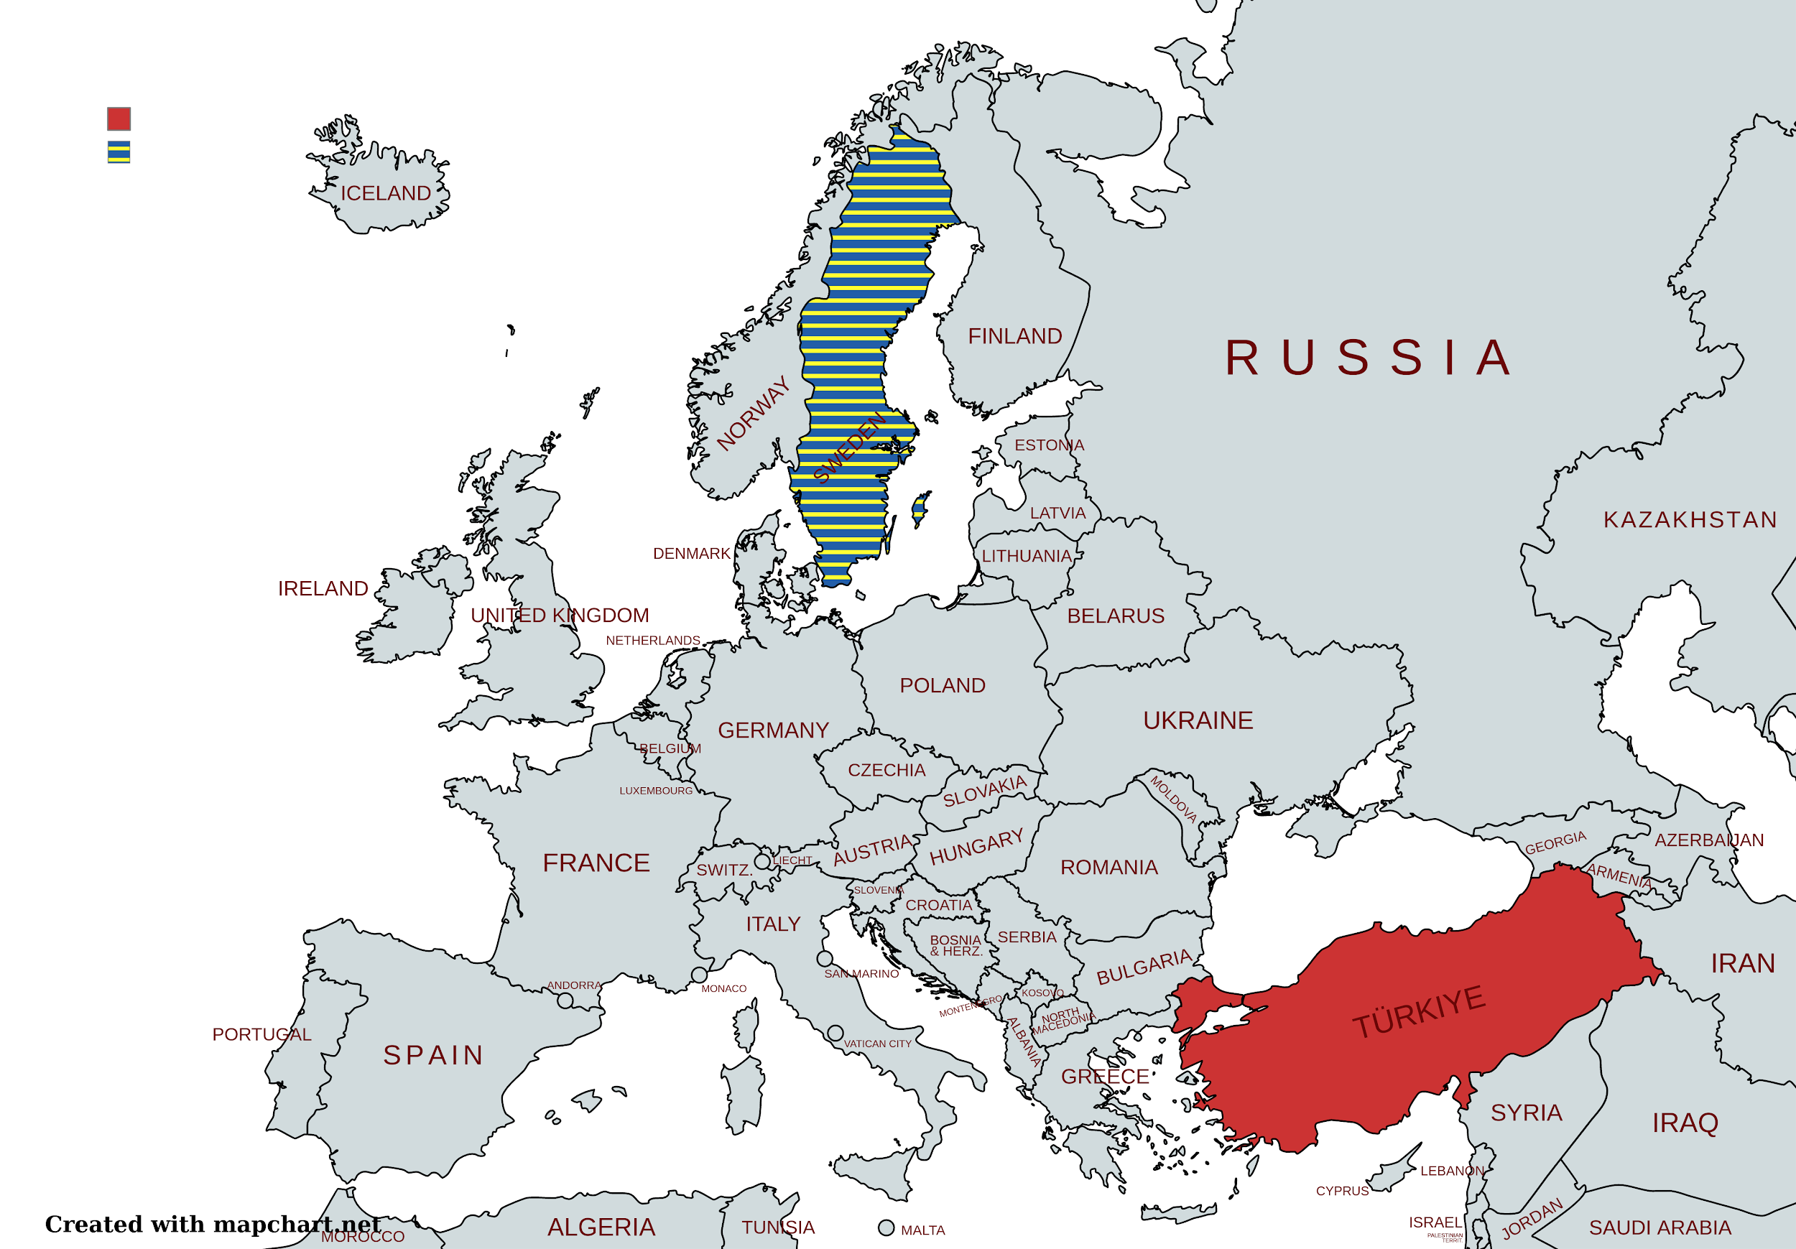
Carrier map to Lise-ZDD project

Slide 3
What are we doing ?

Slide 4

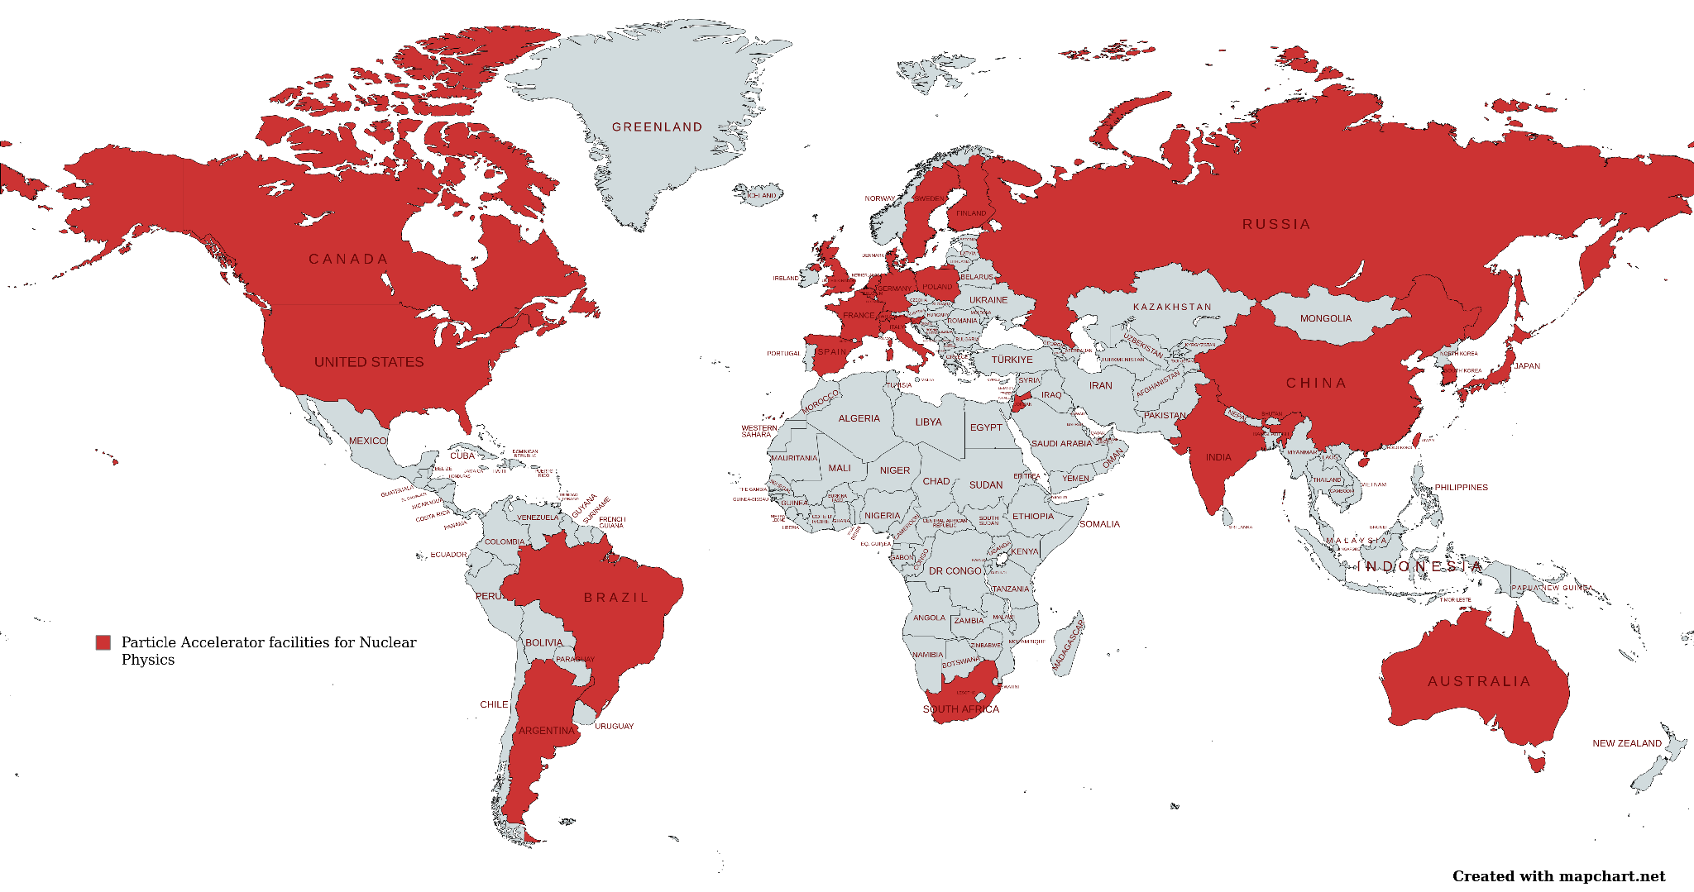
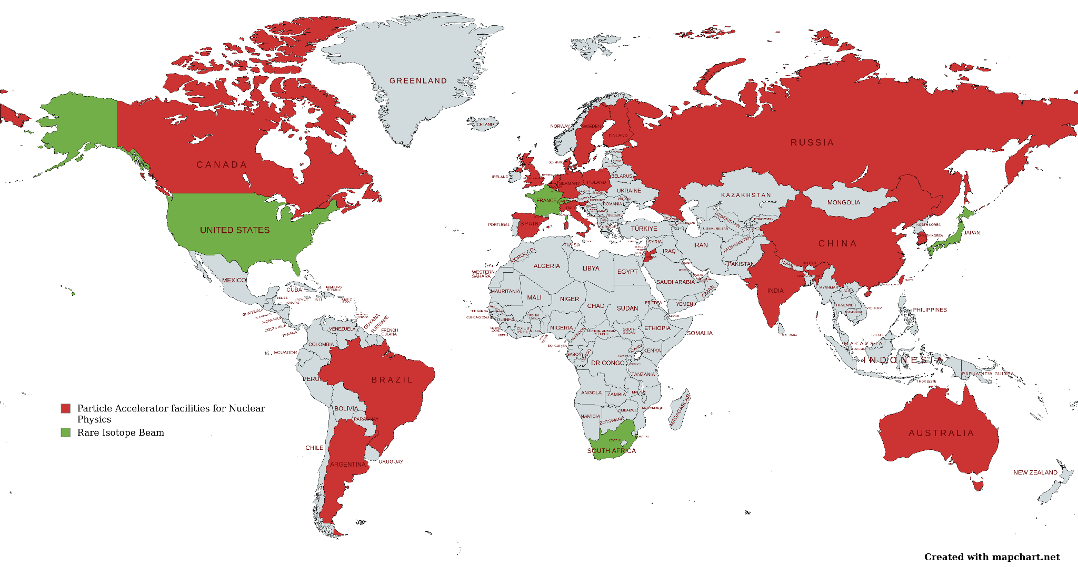
Facilities around the world

Slide 5
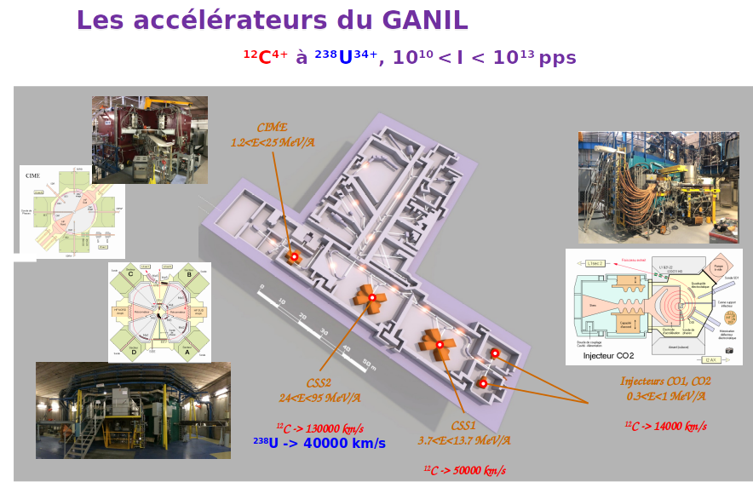
Why Ganil is unique ?

Slide 6
WN founding

